Slide 17
Opening Prayer
God of light, shine in our hearts so that we can bring joy and hope to other people, especially those who are frightened, sick, lonely or hungry. Amen.

Slide 18
Halleluia

Slide 19
Listen Carefully
Reader: A reading from the Holy Gospel according to Matthew 4:12-17
All: Glory to you, O Lord
Reader: The Gospel of the Lord
All: Praise to you, Lord, Jesus Christ.

Slide 22
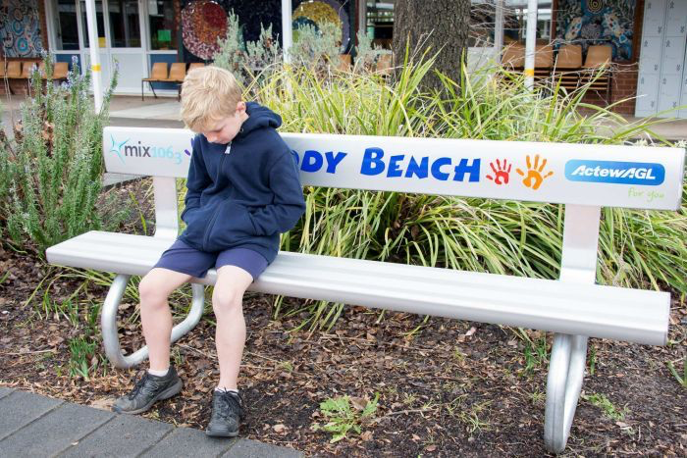
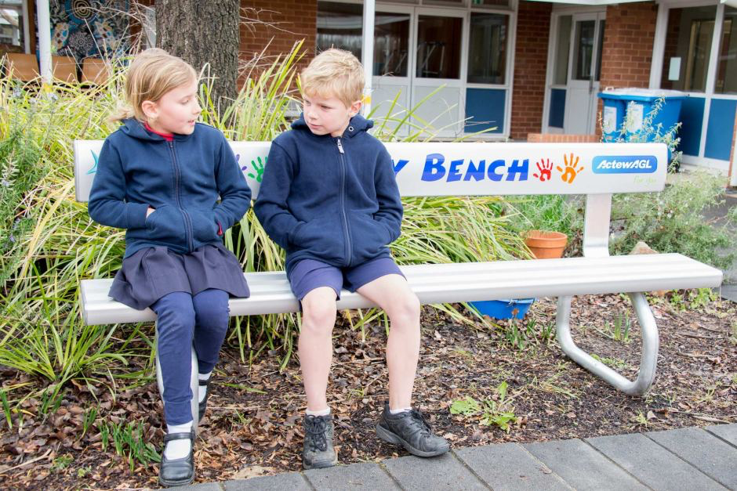
How can you shine the light of Jesus to help others who are in darkness?

Slide 23
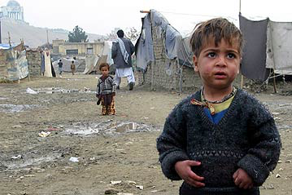
How else can you shine the light of Jesus to help others who are in darkness?

Slide 25
What will you do this week to make the light shine for someone, either here or in another part of the world?

Slide 27
Bidding Prayers
Hear our prayer
Hear our prayer
God of mercy hear our prayer

Slide 28
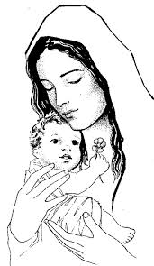
Hail Mary, full of grace, the Lord is with thee, blessed art thou among women and blessed is the fruit of thy womb, Jesus. Holy Mary, Mother of God, pray for us sinners now and at the hour of our death. Amen

Slide 29
Lord, the light of your love is shining
In the midst of the darkness, shining
Jesus, Light of the World, shine upon us
Set us free by the truth You now bring us
Shine on me, shine on me.

Slide 30
Shine, Jesus, shine
Fill this land with the Father's glory
Blaze, Spirit, blaze
Set our hearts on fire
Flow, river, flow
Flood the nations with grace and mercy
Send forth Your word, Lord, and let there be light.

Slide 31
Lord, I come to your awesome presence
From the shadows into Your radiance
By the blood I may enter Your brightness
Search me, try me, consume all my darkness
Shine on me, shine on me.

Slide 32
Shine, Jesus, shine
Fill this land with the Father's glory
Blaze, Spirit, blaze
Set our hearts on fire
Flow, river, flow
Flood the nations with grace and mercy
Send forth Your word
Lord, and let there be light.

Slide 33
As we gaze on Your kingly brightness
So our faces display Your likeness
Ever changing from glory to glory
Mirrored here may our lives tell Your story
Shine on me, shine on me.

Slide 34
Shine, Jesus, shine
Fill this land with the Father's glory
Blaze, Spirit, blaze
Set our hearts on fire
Flow, river, flow
Flood the nations with grace and mercy
Send forth your word
Lord, and let there be light.

Slide 35
Closing Prayer God of hope, share your light with all your children, as we try to help others who are in need. Amen.

