Slide 1
Year 5 / 6 Residential 2020
Parent Information Meeting
20.06.2019

Slide 2
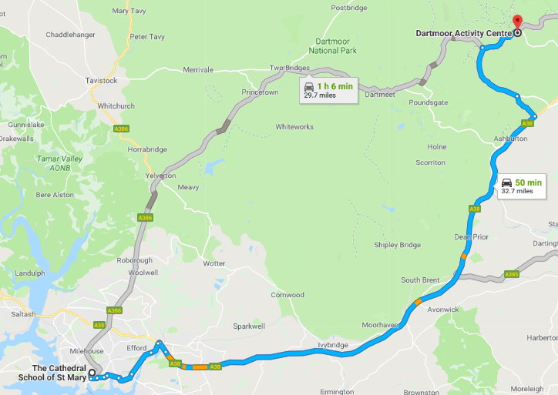
Key Information
Dates
18th – 22nd May 2020
Location
Dartmoor Activity Centre
Journey Time
1 hour

Slide 3
Key Information
Staffing:
Mr Driscoll
Mrs Ellard
One other

Slide 4
Key Information
Cost and Payment
£150
Payment can be taken in instalments via ParentPay or directly through the office
£50 deposit by 27th September (again can be paid in instalments)*
Those who have already paid, your deposit will be transferred.
Balance to be paid by 1st May 2020

Slide 5
Key Information...
Pre-trip preparations:
Pack bags - Please ensure that the children pack their bag with you so that they know how to re-pack on Wednesday. Please make sure your child can carry their bag. We suggest that you pack the sleeping bag and pillow in one bag and clothes/toiletries in another. PLEASE LABEL BOTH BAGS CLEARLY.
Please remember that we are only going for two nights and pack accordingly. (See kit list for suggested items).
Medications and correctly completed forms MUST be handed to Mrs Ellard (including travel sickness) on Monday morning. Please label medication clearly. Do not pack in clothing bag.

Slide 6
Key Information...
Monday 18th May
08:30 - 09:00 - Arrive in school as usual. Please remember the children’s bags! (and medication)
09:00 - 09:15 - Safety talk
09:15 - 09:30 - Preparations for travel
09:30 - Depart
Please ensure that you administer any travel sickness medication with this departure time in mind (many recommend administering 60 minutes before travel)

Slide 7
Key Information...
Monday 18th May
09:30 - 10:30 - Travel
10:30 - 11:00 - Arrival and unloading
11:00 - 12:00 - Health and safety talk, centre walk and lunch
PLEASE ENSURE YOU PACK A LUNCH (INCLUDING DRINK) FOR THE FIRST DAY
12:00 - Activities begin

Slide 8
Key Information...
A typical day will consist of:
07:00 - 07:30 - Staggered showers
07:30 - 08:00 - Dress and tidy rooms
08:00 - 08:10 - Room Inspection
08:10 - 08:30 - Free time
08:30 - 09:00 - Breakfast
09:00 - 09:30 - Prepare for the day
09:30 - Activities begin Lights out - 21:30

Slide 9
Key Information...
Activities are likely to include:
The Key to your dorm challenge (you can’t get into your rooms at night, until the codes are cracked !)
Moorland orienteering
The stars at night, as seen from Dartmoor
Bush craft, and all that comes under that heading
Team building challenges
Bridge building
Bonfire with the crucial marshmallows

Slide 10
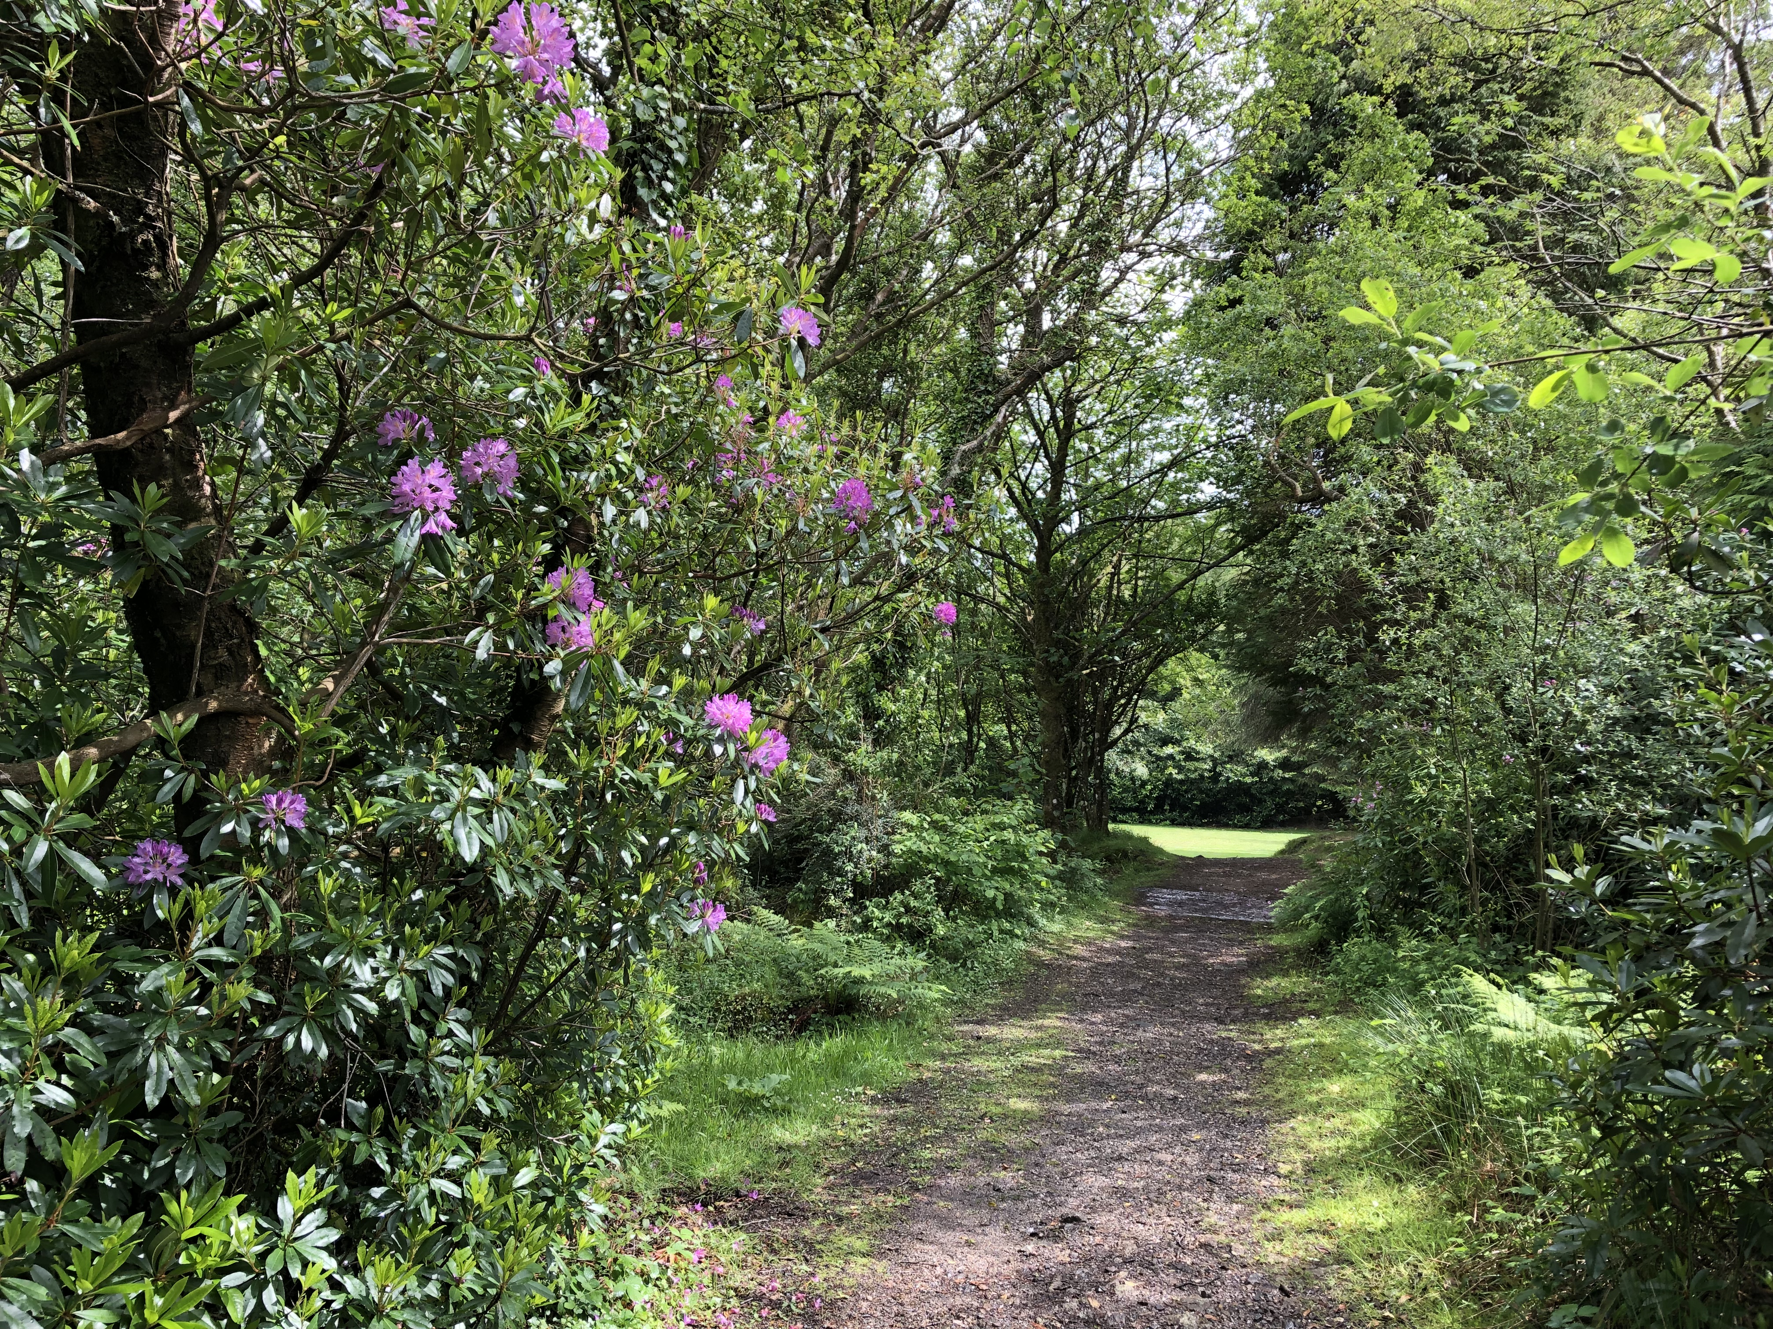

Slide 11
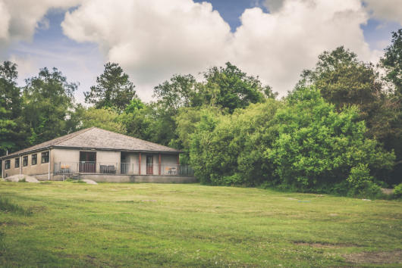

Slide 12
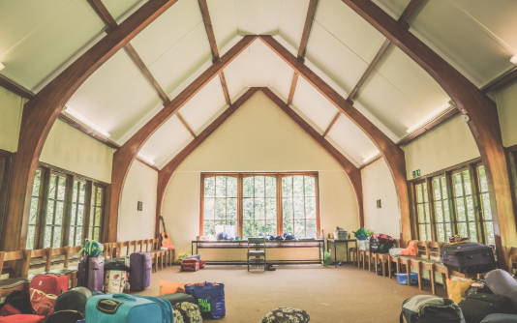

Slide 13
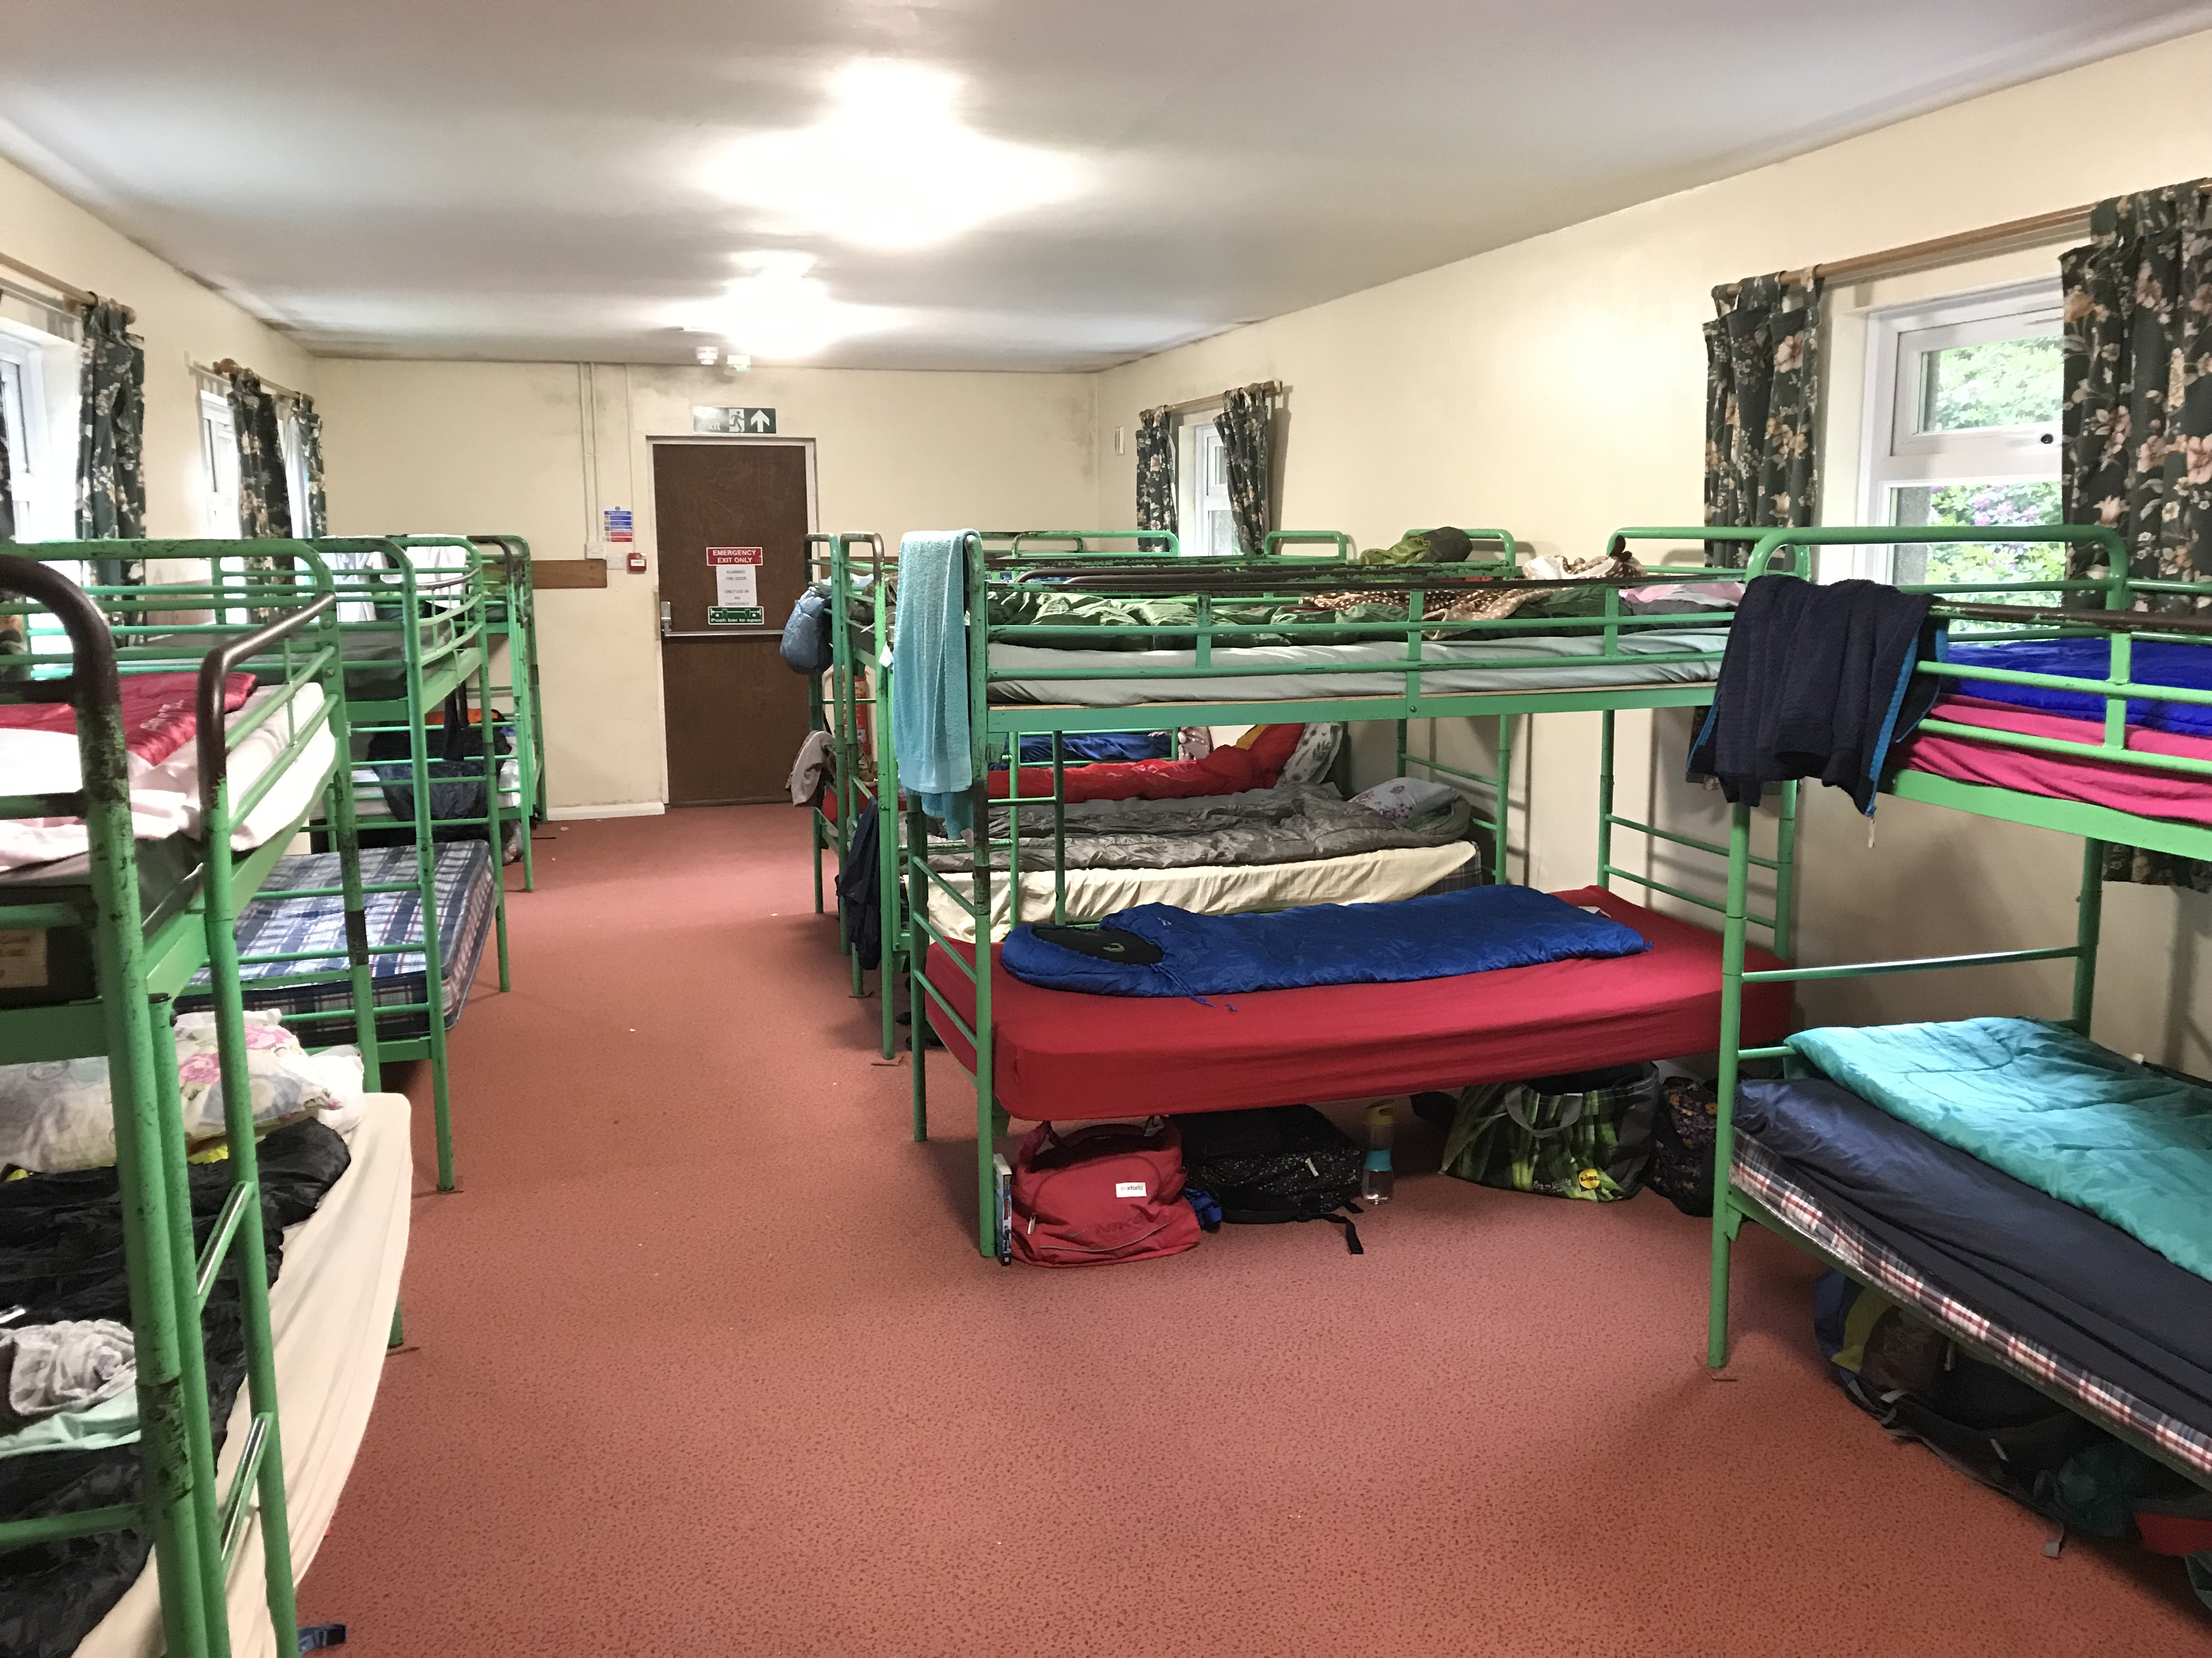

Slide 14
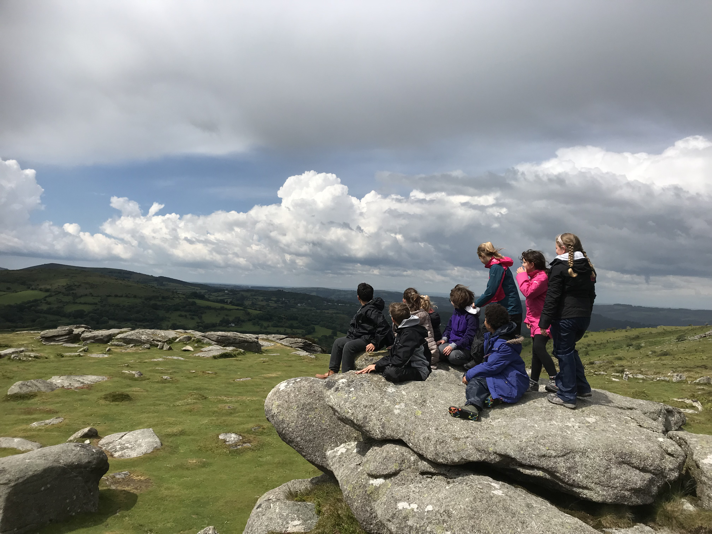

Slide 15
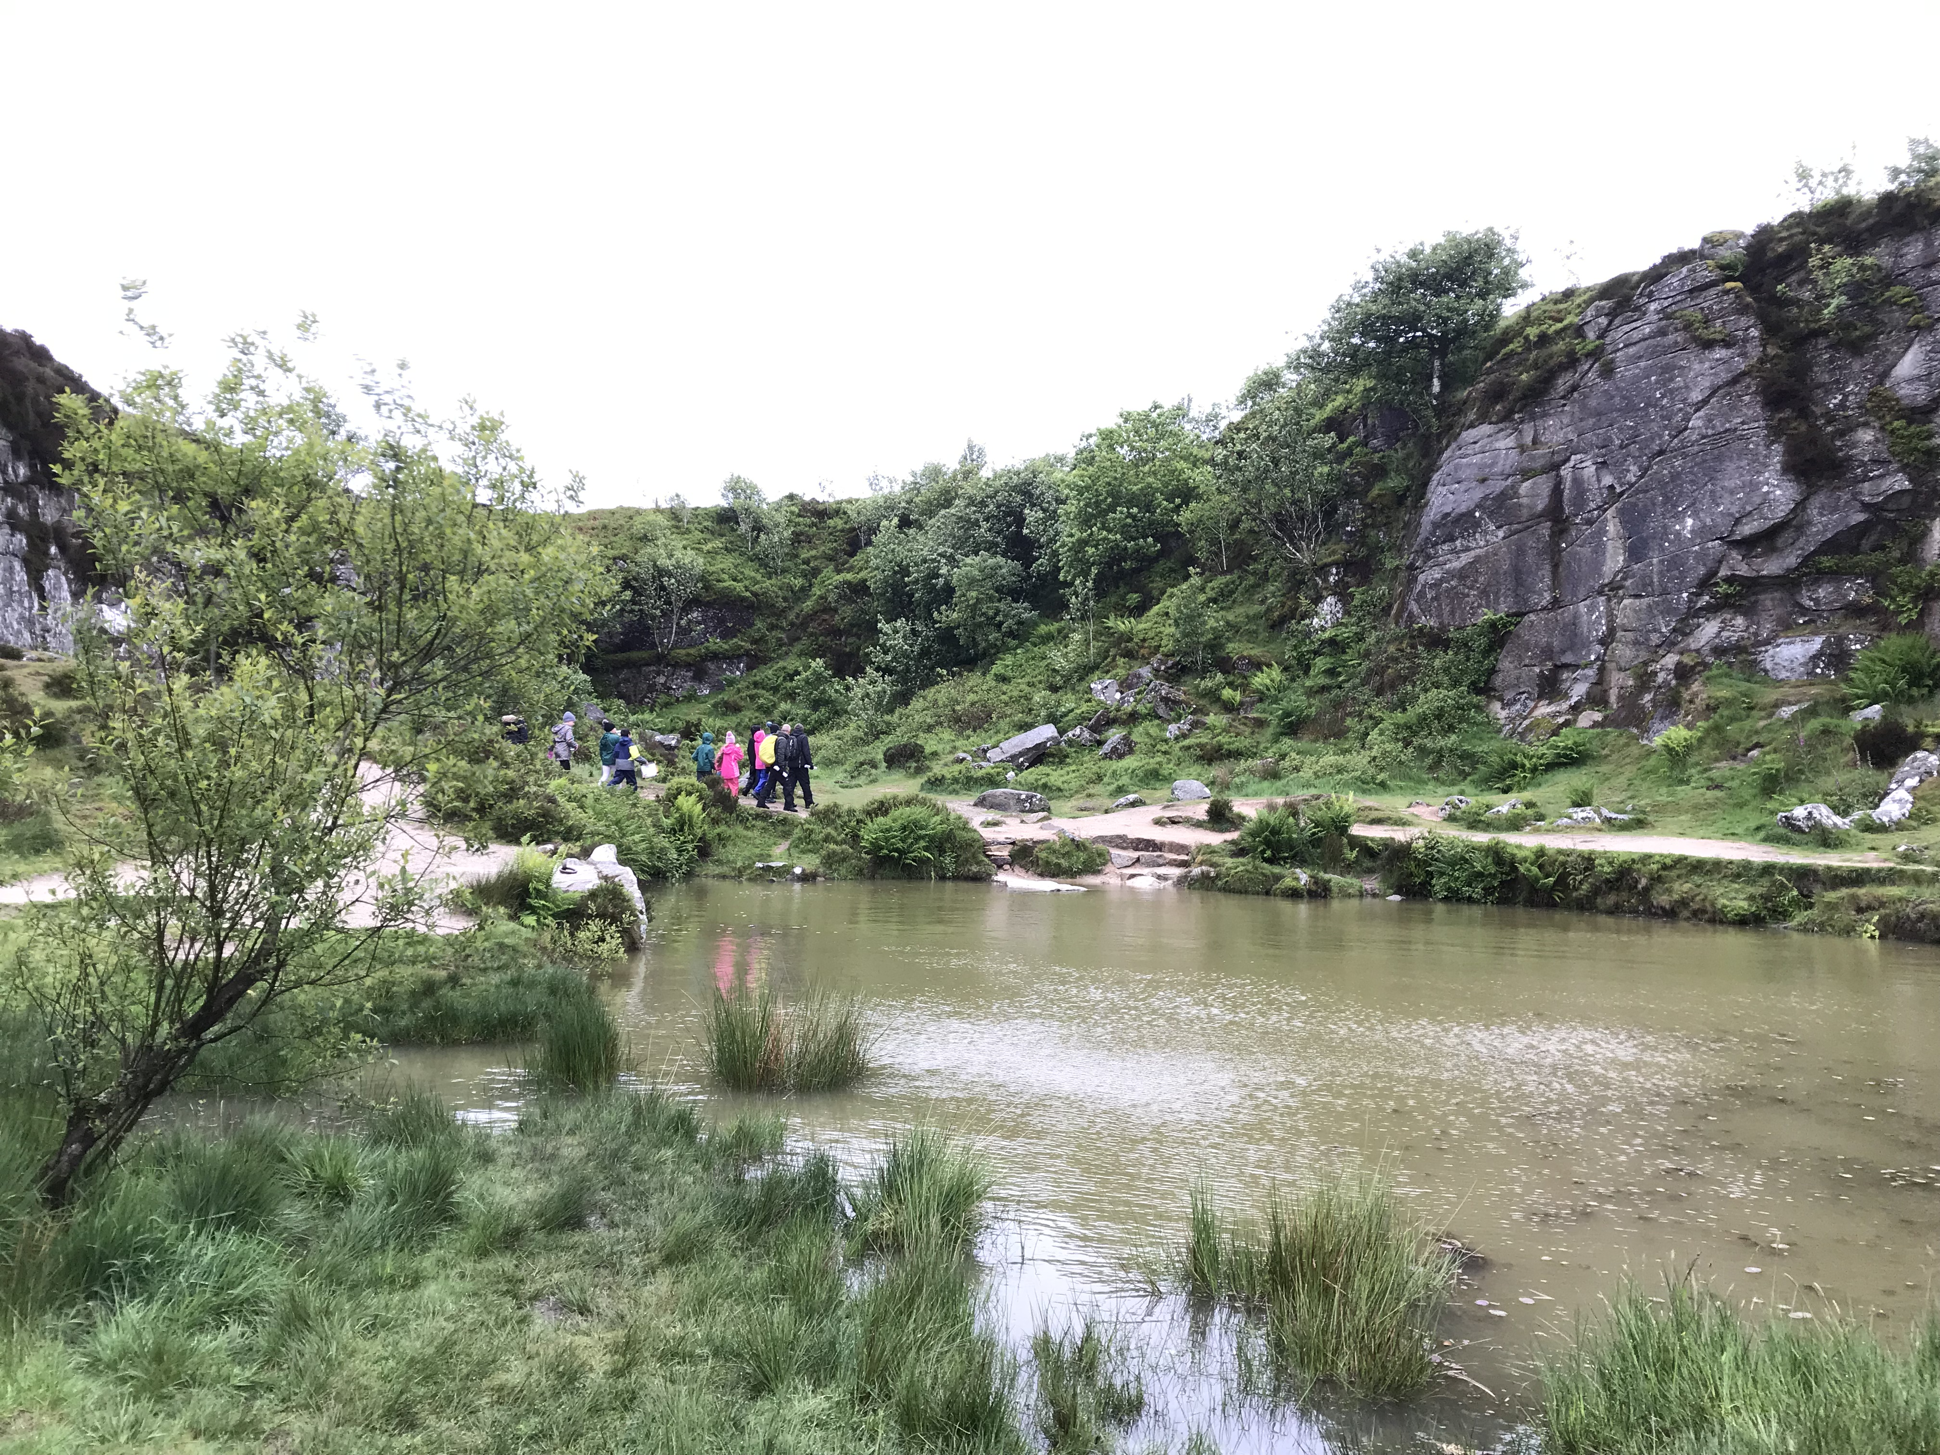

Slide 16
Item | Quantity | Item | Quantity
Waterproof coat | 1 | Bedding (Sleeping bag, pillow, fitted single bed sheet) | 1
Waterproof trousers | 1 | Towel | 1
Warm jumper | 2 | Wash bag (Shampoo, soap etc) | 1
T-shirt | 6 | Toothbrush and paste | 1
Trousers / leggings (No Shorts) | 3 | Gloves | 1 (pair)
Underwear | 7 | Sunblock | 1
Socks (pairs) | 7 | Insect Repellent | 1
Walking boots | 1 | Torch | 1
Trainers (for campsite) | 1 | Reading Book | 1
Warm nightwear (Including slippers) | 1 | Packed Lunch (for day 1) | 1
Wooly hat / sun hat | 1 | Medication | N/A
Notes:
Please let us know if you cannot provide one or more of these items and we will try to get them for you.

Slide 17
What not to bring...
Please do not allow your child to bring:
Mobile phones / personal electronic devices
No makeup
No aerosols
No hair dryers / straighteners
No sweets or snacks (Other than packed lunch on day 1)
No money
No expensive clothing that might get damaged / lost
No jewellery
We will not accept responsibility for any lost or damaged items.

Slide 18
How to follow us!?
We will be posting regularly on the ClassDojo story and the school Facebook page. This will include pictures and write-ups of the activities.
If you need to contact us while we are away, please do so via the school office and not the residential centre or social media.

Slide 19
Key Information...
Collection - Friday 22nd May
07:00 - 11:00 - Morning activities
11:00 - Depart
11:00 - 12:30 - Travel
12:30 - Arrival back at school
13:30 - Children can be collected from school.

