Slide 1
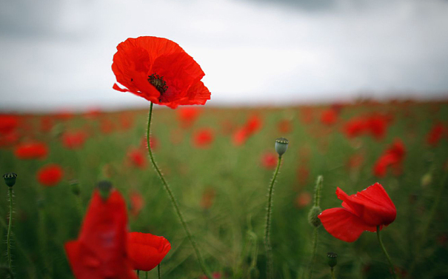
We remember…

Slide 2
Today
at the eleventh hour
of the eleventh day
of the eleventh month
we remember all those who have sacrificed their lives in conflicts
so that we might be free.

Slide 3
We honour their memories
as we pray for peace
in our world.

Slide 4
As we mark Armistice Day,
let us remind ourselves
of Jesus’ message to us all.

Slide 5
A reading from the Holy Gospel according to Mark
Response: Glory to you O Lord.
The Gospel of the Lord.
Response: Praise to You, Lord Jesus Christ.

Slide 6
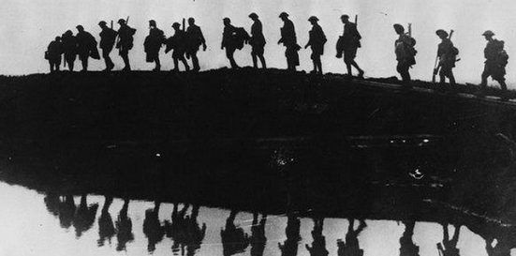
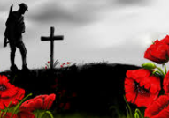
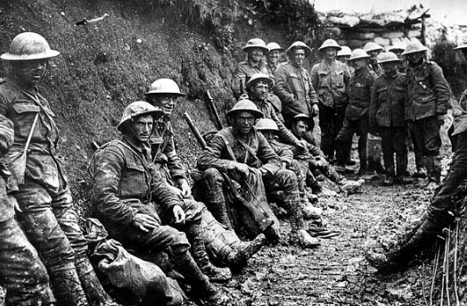
Litany for Peace

Slide 7
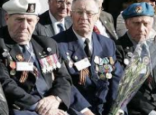
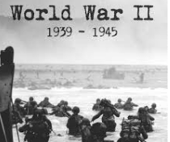
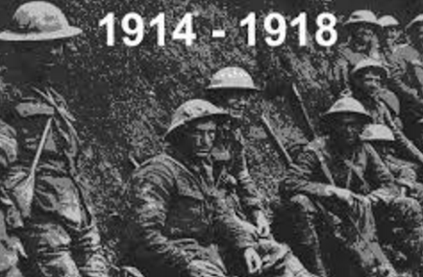
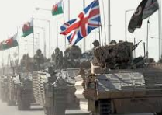
They shall grow not old, as we that are left grow old,
Age shall not weary them, nor the years condemn.
At the going down of the sun, and in the morning
We will remember them.
Response: We will remember them.

Slide 8
Make me a channel of your peace.
Where there is hatred, let me bring your love.
Where there is injury, your pardon Lord,
And where’s there doubt, true faith in you.

Slide 9
Make me a channel of your peace,
Where there’s despair in life, let me bring hope.
Where there is darkness only light,
And where there’s sadness ever joy.

Slide 10
Oh Master, grant that I may never seek
So much to be consoled as to console,
To be understood as to understand,
To be loved, as to love, with all my soul.

Slide 11
Make me a channel of your peace,
It is in pardoning that we are pardoned.
In giving to all men that we receive,
And in dying that we’re born to eternal life.

Slide 12
We remember…

